Slide 1
Bayesian Evals
December 2024

Slide 2
Evaluating AI Systems is hard
Training set contamination
Differences in formatting/prompting lead to changes in performance
So many eval datasets to use, so little time– e.g. big bench has 204 tasks
Can try model-generated evals but then you get an ouroboros of evals
How best to model uncertainty in evals?
How to test for subjective quality of generations (not MCQA)
A/B tests (e.g. chatbot arena -> Elo scores) – expensive, difficult to model uncertainty
Red teaming – difficult, not standardised
See Anthropic blog: “Challenges in evaluating AI systems” (2023)

Slide 3
Evaluating AI Systems is hard
Training set contamination
Differences in formatting/prompting lead to changes in performance
So many eval datasets to use, so little time– e.g. big bench has 204 tasks
Can try model-generated evals but then you get an ouroboros of evals
How best to model uncertainty in evals?
How to test for subjective quality of generations (not MCQA)
A/B tests (e.g. chatbot arena -> Elo scores) – expensive, difficult to model uncertainty
Red teaming – difficult, not standardised
See Anthropic blog: “Challenges in evaluating AI systems” (2023)

Slide 4
Evaluating AI Systems is hard
Training set contamination
Differences in formatting/prompting lead to changes in performance
So many eval datasets to use, so little time– e.g. big bench has 204 tasks
Can try model-generated evals but then you get an ouroboros of evals
How best to model uncertainty in evals?
How to test for subjective quality of generations (not MCQA)
A/B tests (e.g. chatbot arena -> Elo scores) – expensive, difficult to model uncertainty
Red teaming – difficult, not standardised
See Anthropic blog: “Challenges in evaluating AI systems” (2023)

Slide 5
Evaluating AI Systems is hard
Training set contamination
Differences in formatting/prompting lead to changes in performance
So many eval datasets to use, so little time– e.g. big bench has 204 tasks
Can try model-generated evals but then you get an ouroboros of evals
How best to model uncertainty in evals?
How to test for subjective quality of generations (not MCQA)
A/B tests (e.g. chatbot arena -> Elo scores) – expensive, difficult to model uncertainty
Red teaming – difficult, not standardised
See Anthropic blog: “Challenges in evaluating AI systems” (2023)

Slide 6
Evaluating AI Systems is hard
Training set contamination
Differences in formatting/prompting lead to changes in performance
So many eval datasets to use, so little time– e.g. big bench has 204 tasks
Can try model-generated evals but then you get an ouroboros of evals
How best to model uncertainty in evals?
How to test for subjective quality of generations (not MCQA)
A/B tests (e.g. chatbot arena -> Elo scores) – expensive, difficult to model uncertainty
Red teaming – difficult, not standardised
See Anthropic blog: “Challenges in evaluating AI systems” (2023)

Slide 7
Evaluating AI Systems is hard
Training set contamination
Differences in formatting/prompting lead to changes in performance
So many eval datasets to use, so little time– e.g. big bench has 204 tasks
Can try model-generated evals but then you get an ouroboros of evals
How best to model uncertainty in evals?
How to test for subjective quality of generations (not MCQA)
A/B tests (e.g. chatbot arena -> Elo scores) – expensive, difficult to model uncertainty
Red teaming – difficult, not standardised
See Anthropic blog: “Challenges in evaluating AI systems” (2023)

Slide 8
Evaluating AI Systems is hard
Training set contamination
Differences in formatting/prompting lead to changes in performance
So many eval datasets to use, so little time– e.g. big bench has 204 tasks
Can try model-generated evals but then you get an ouroboros of evals
How best to model uncertainty in evals?
How to test for subjective quality of generations (not MCQA)
A/B tests (e.g. chatbot arena -> Elo scores) – expensive, difficult to model uncertainty
Red teaming – difficult, not standardised
See Anthropic blog: “Challenges in evaluating AI systems” (2023)

Slide 9
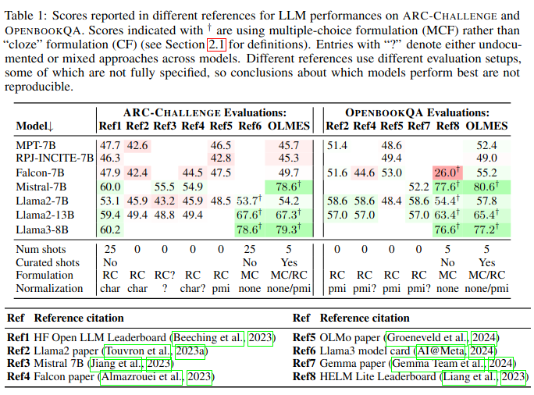
OLMES (Open Language Model Evaluation Standard) - Gu et al.
Considers the uncertainty between different experiment setups
But not the uncertainty inside each eval experiment
(that is, inter-model uncertainty but not intra-model uncertainty)

Slide 10
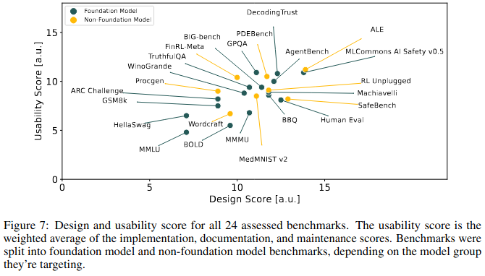
BetterBench – Reuel et al.
Methodology for evaluating quality of benchmarks
“14 out of 24 benchmarks did not perform multiple evaluations of the same model or report statistical significance or uncertainty of results”
“an average score of 5.62 [out of 15] on Reporting statistical significance”

Slide 11
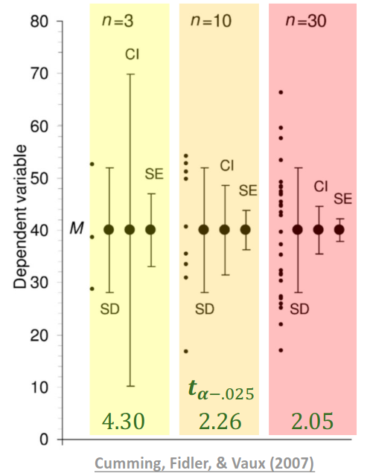
What to report in your evals
Accuracy (overall and per-task) averaged over n runs
With error bars:
Using standard error rather than standard deviation:
Uncertainty in the estimate of the mean, not just the spread of data
How can we represent the facts that
Each benchmark/task might be of different quality?
Each model may be more/less capable/consistent on a different subset of benchmarks/tasks?
How can we use these error bars to consider the probability with which we can say “Model A > Model B”?
See Neurips slides by Hermann et al. (2024) for more

Slide 12
What to report in your evals
Accuracy (overall and per-task) averaged over n runs
With error bars:
Using standard error rather than standard deviation:
Uncertainty in the estimate of the mean, not just the spread of data
How can we represent the facts that
Each benchmark/task might be of different quality?
Each model may be more/less capable/consistent on a different subset of benchmarks/tasks?
How can we use these error bars to consider the probability with which we can say “Model A > Model B”?
See Neurips slides by Hermann et al. (2024) for more

Slide 13
What to report in your evals
Accuracy (overall and per-task) averaged over n runs
With error bars:
Using standard error rather than standard deviation:
Uncertainty in the estimate of the mean, not just the spread of data
How can we represent the facts that
Each benchmark/task might be of different quality?
Each model may be more/less capable/consistent on a different subset of benchmarks/tasks?
How can we use these error bars to consider the probability with which we can say “Model A > Model B”?
See Neurips slides by Hermann et al. (2024) for more

Slide 14
What to report in your evals
Accuracy (overall and per-task) averaged over n runs
With error bars:
Using standard error rather than standard deviation:
Uncertainty in the estimate of the mean, not just the spread of data
How can we represent the facts that
Each benchmark/task might be of different quality?
Each model may be more/less capable/consistent on a different subset of benchmarks/tasks?
How can we use these error bars to consider the probability with which we can say “Model A > Model B”?
See Neurips slides by Hermann et al. (2024) for more

Slide 15

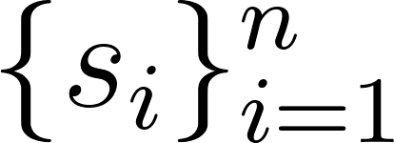



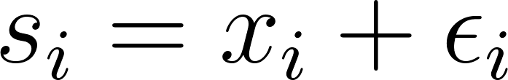
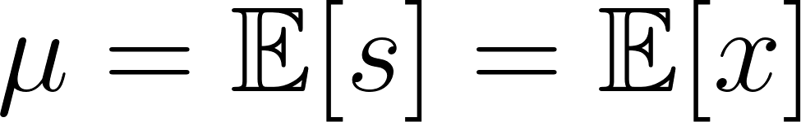
Set up
Suppose we have questions, and our model achieves scores (between 0 and 1) where can be decomposed into a mean component and a zero-mean random component .
We want to infer

Slide 16
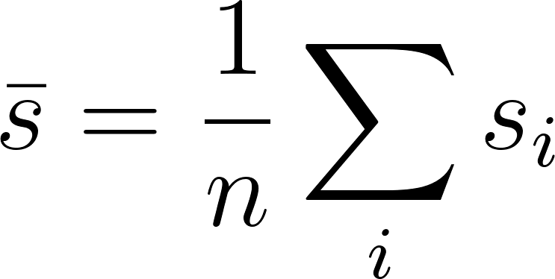
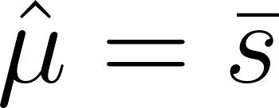
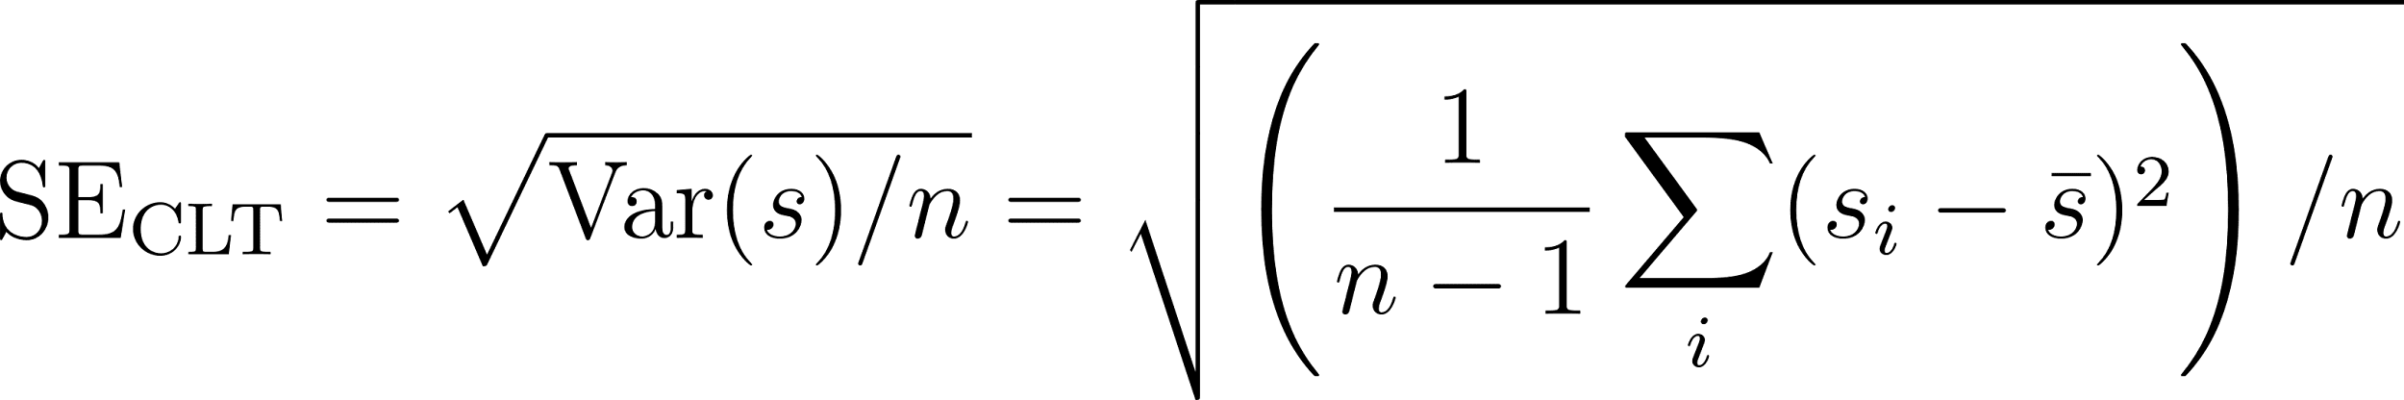
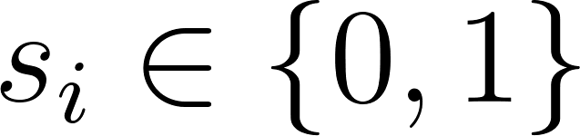
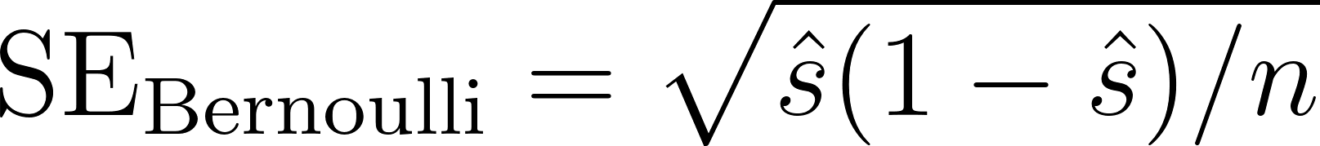

Frequentist Error Bars
Let . Then by the law of large numbers:
CLT:
If then this becomes
Obtain 95% confidence intervals as
(if you do the data collection 100 times, 95 of those times you’ll get )

Slide 17
Frequentist Error Bars
Let . Then by the law of large numbers:
CLT:
If then this becomes
Obtain 95% confidence intervals as
(if you do the data collection 100 times, 95 of those times you’ll get )

Slide 18
Frequentist Error Bars
Let . Then by the law of large numbers:
CLT:
If then this becomes
Obtain 95% confidence intervals as
(if you do the data collection 100 times, 95 of those times you’ll get )

Slide 19
Frequentist Error Bars
Let . Then by the law of large numbers:
CLT:
If then this becomes
Obtain 95% confidence intervals as
(if you do the data collection 100 times, 95 of those times you’ll get )

Slide 20


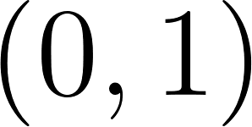
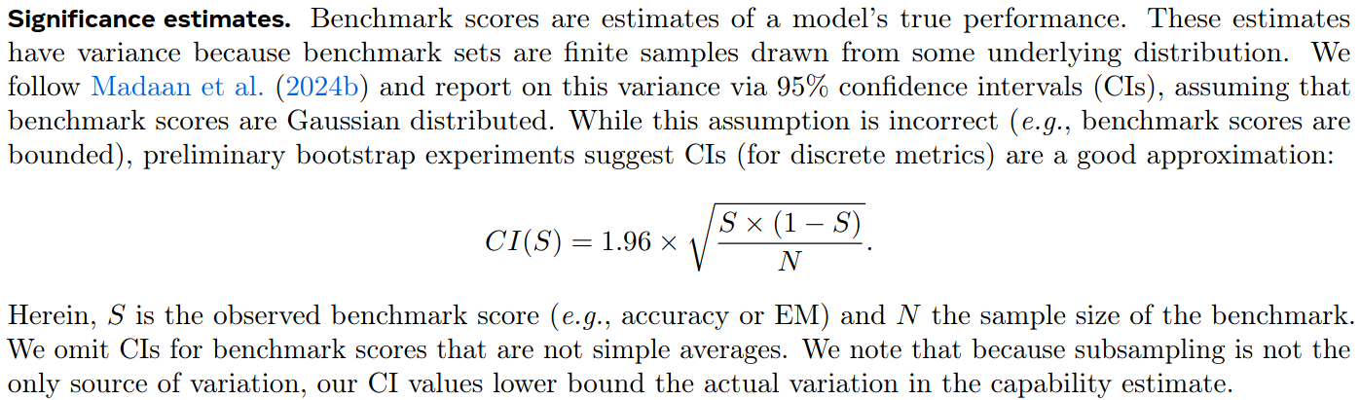
Anthropic Paper “Adding Error Bars to Evals” (Miller, 2024)
Points out that the LLama 3 (Dubey et al., 2024) paper reports only , even when can take on values in (e.g. F1 score). This leads to confidence intervals that are too wide.

Slide 21
Anthropic Paper “Adding Error Bars to Evals” (Miller, 2024)
Points out that the LLama 3 (Dubey et al., 2024) paper reports only , even when can take on values in (e.g. F1 score). This leads to confidence intervals that are too wide.

Slide 22
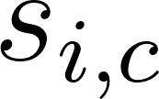


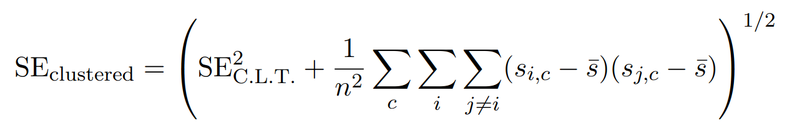
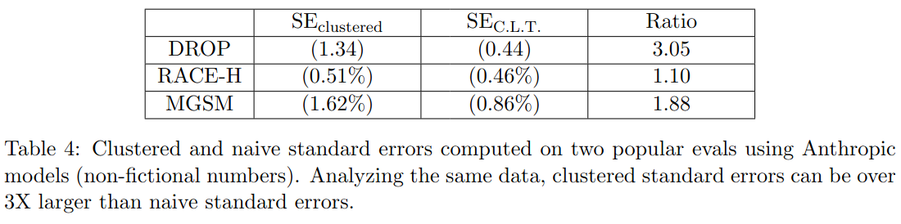
Anthropic Paper “Adding Error Bars to Evals” (Miller, 2024)
In reality, questions come in groups from different tasks (e.g. boolean_expression, date_understanding from BBH), so the IID assumption of the CLT is violated.
Therefore suggests using clustered standard error, where is the th question from cluster/task
“sliding scale between cases where scores
within a cluster are perfectly correlated ([...] each cluster acts as a single indep. observation) and perfectly uncorrelated”

Slide 23
Anthropic Paper “Adding Error Bars to Evals” (Miller, 2024)
In reality, questions come in groups from different tasks (e.g. boolean_expression, date_understanding from BBH), so the IID assumption of the CLT is violated.
Therefore suggests using clustered standard error, where is the th question from cluster/task
“sliding scale between cases where scores
within a cluster are perfectly correlated ([...] each cluster acts as a single indep. observation) and perfectly uncorrelated”

Slide 24
Anthropic Paper “Adding Error Bars to Evals” (Miller, 2024)
In reality, questions come in groups from different tasks (e.g. boolean_expression, date_understanding from BBH), so the IID assumption of the CLT is violated.
Therefore suggests using clustered standard error, where is the th question from cluster/task
“sliding scale between cases where scores
within a cluster are perfectly correlated ([...] each cluster acts as a single indep. observation) and perfectly uncorrelated”

Slide 25





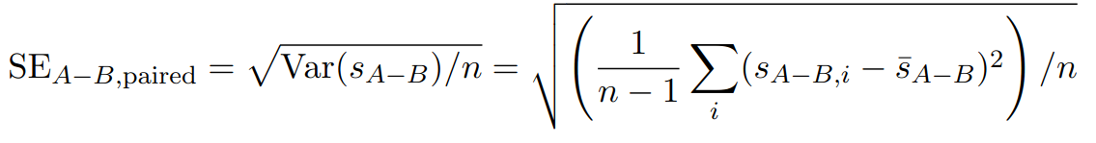
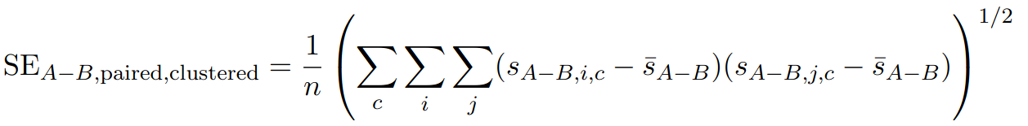
Anthropic Paper “Adding Error Bars to Evals” (Miller, 2024)
How to compare two models, A and B?
Naively:
But if you know the set of questions used for A and B’s evals you can do paired analysis:
Or with clustering:

Slide 26
Anthropic Paper “Adding Error Bars to Evals” (Miller, 2024)
How to compare two models, A and B?
Naively:
But if you know the set of questions used for A and B’s evals you can do paired analysis:
Or with clustering:

Slide 27
Anthropic Paper “Adding Error Bars to Evals” (Miller, 2024)
How to compare two models, A and B?
Naively:
But if you know the set of questions used for A and B’s evals you can do paired analysis:
Or with clustering:

Slide 28
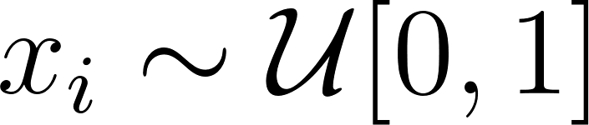
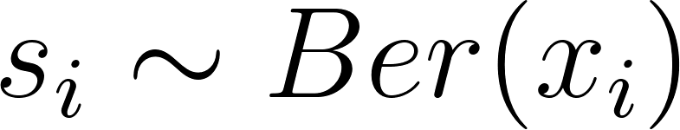
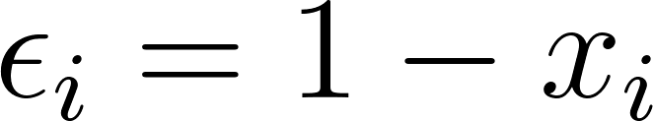

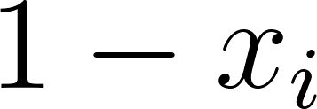
How are we modelling the process of evals?
So far just used CLT/Gaussianity assumption – can we do better?
Anthropic paper suggests (briefly) and so with probability and with probability .
Desi’s blogs go into more detail with Binomial modelling.

Slide 29
How are we modelling the process of evals?
So far just used CLT/Gaussianity assumption – can we do better?
Anthropic paper suggests (briefly) and so with probability and with probability .
Desi’s blogs go into more detail with Binomial modelling.

Slide 30
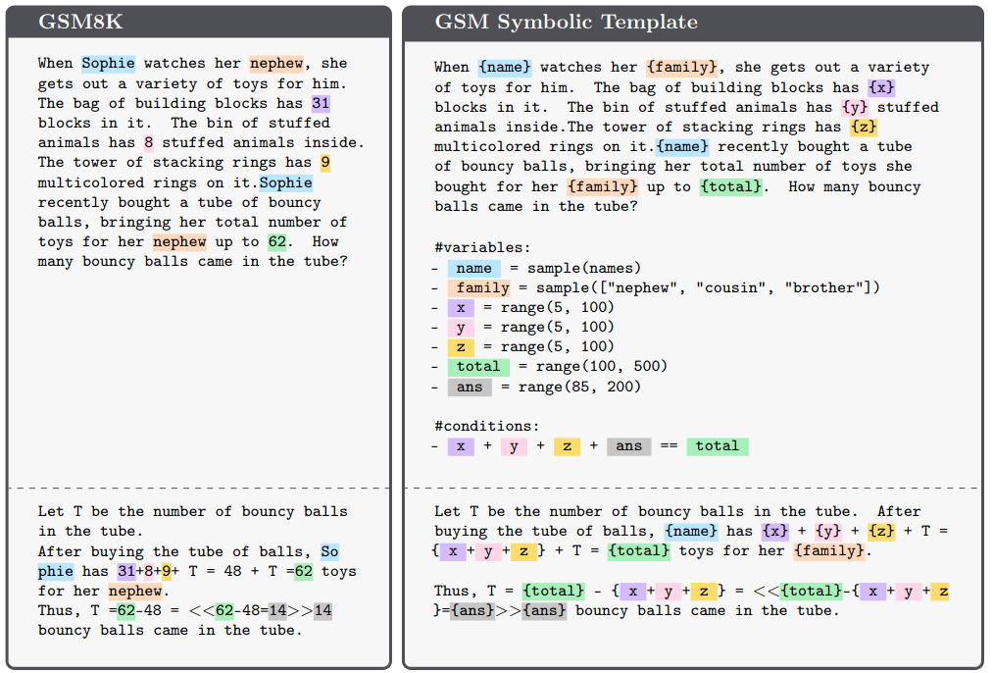
Desi’s Blog
Examines “GSM-Symbolic: Understanding the Limitations of Mathematical Reasoning in Large Language Models” by Mirzadeh et al. (2024) which:
Takes the popular maths benchmark GSM8K and creates a new version GSM-Symbolic in which we can have “same questions, different numbers”
Claims that:
Models exhibit worse performance on GSM-Symbolic than GSM8K; and
This implies that “current LLMs are not capable of genuine logical reasoning; instead, they attempt to replicate the reasoning steps observed in their training data”

Slide 31
Desi’s Blog
Examines “GSM-Symbolic: Understanding the Limitations of Mathematical Reasoning in Large Language Models” by Mirzadeh et al. (2024) which:
Takes the popular maths benchmark GSM8K and creates a new version GSM-Symbolic in which we can have “same questions, different numbers”
Claims that:
Models exhibit worse performance on GSM-Symbolic than GSM8K; and
This implies that “current LLMs are not capable of genuine logical reasoning; instead, they attempt to replicate the reasoning steps observed in their training data”

Slide 32
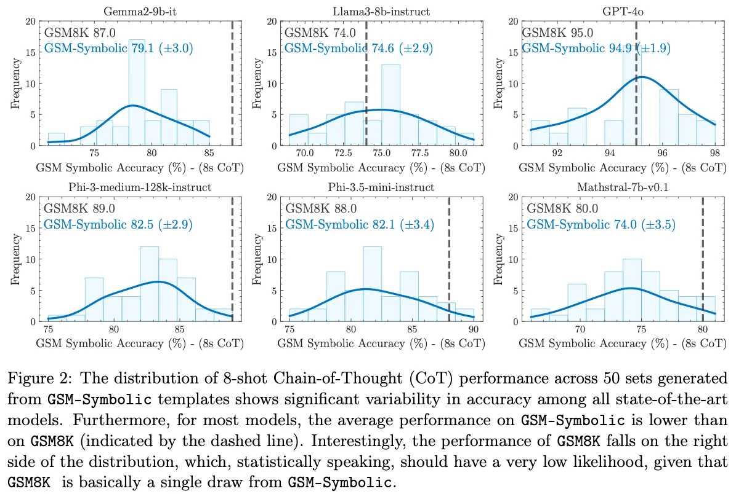
But claim 1 needs backing up
Mirzadeh et al. create 50 versions of GSM-Symbolic and run evals for various models
Compare against a point estimate for GSM8K
Assumption: if a model is doing ‘logic’ then its performance on these datasets should be equivalent.

Slide 33

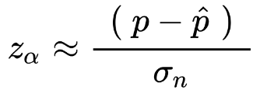
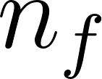
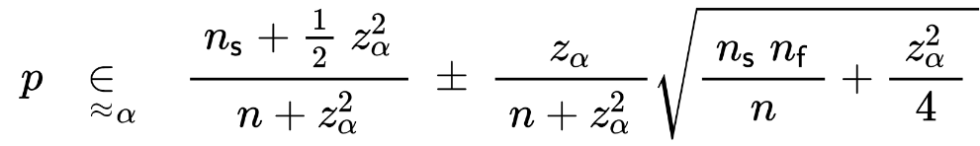



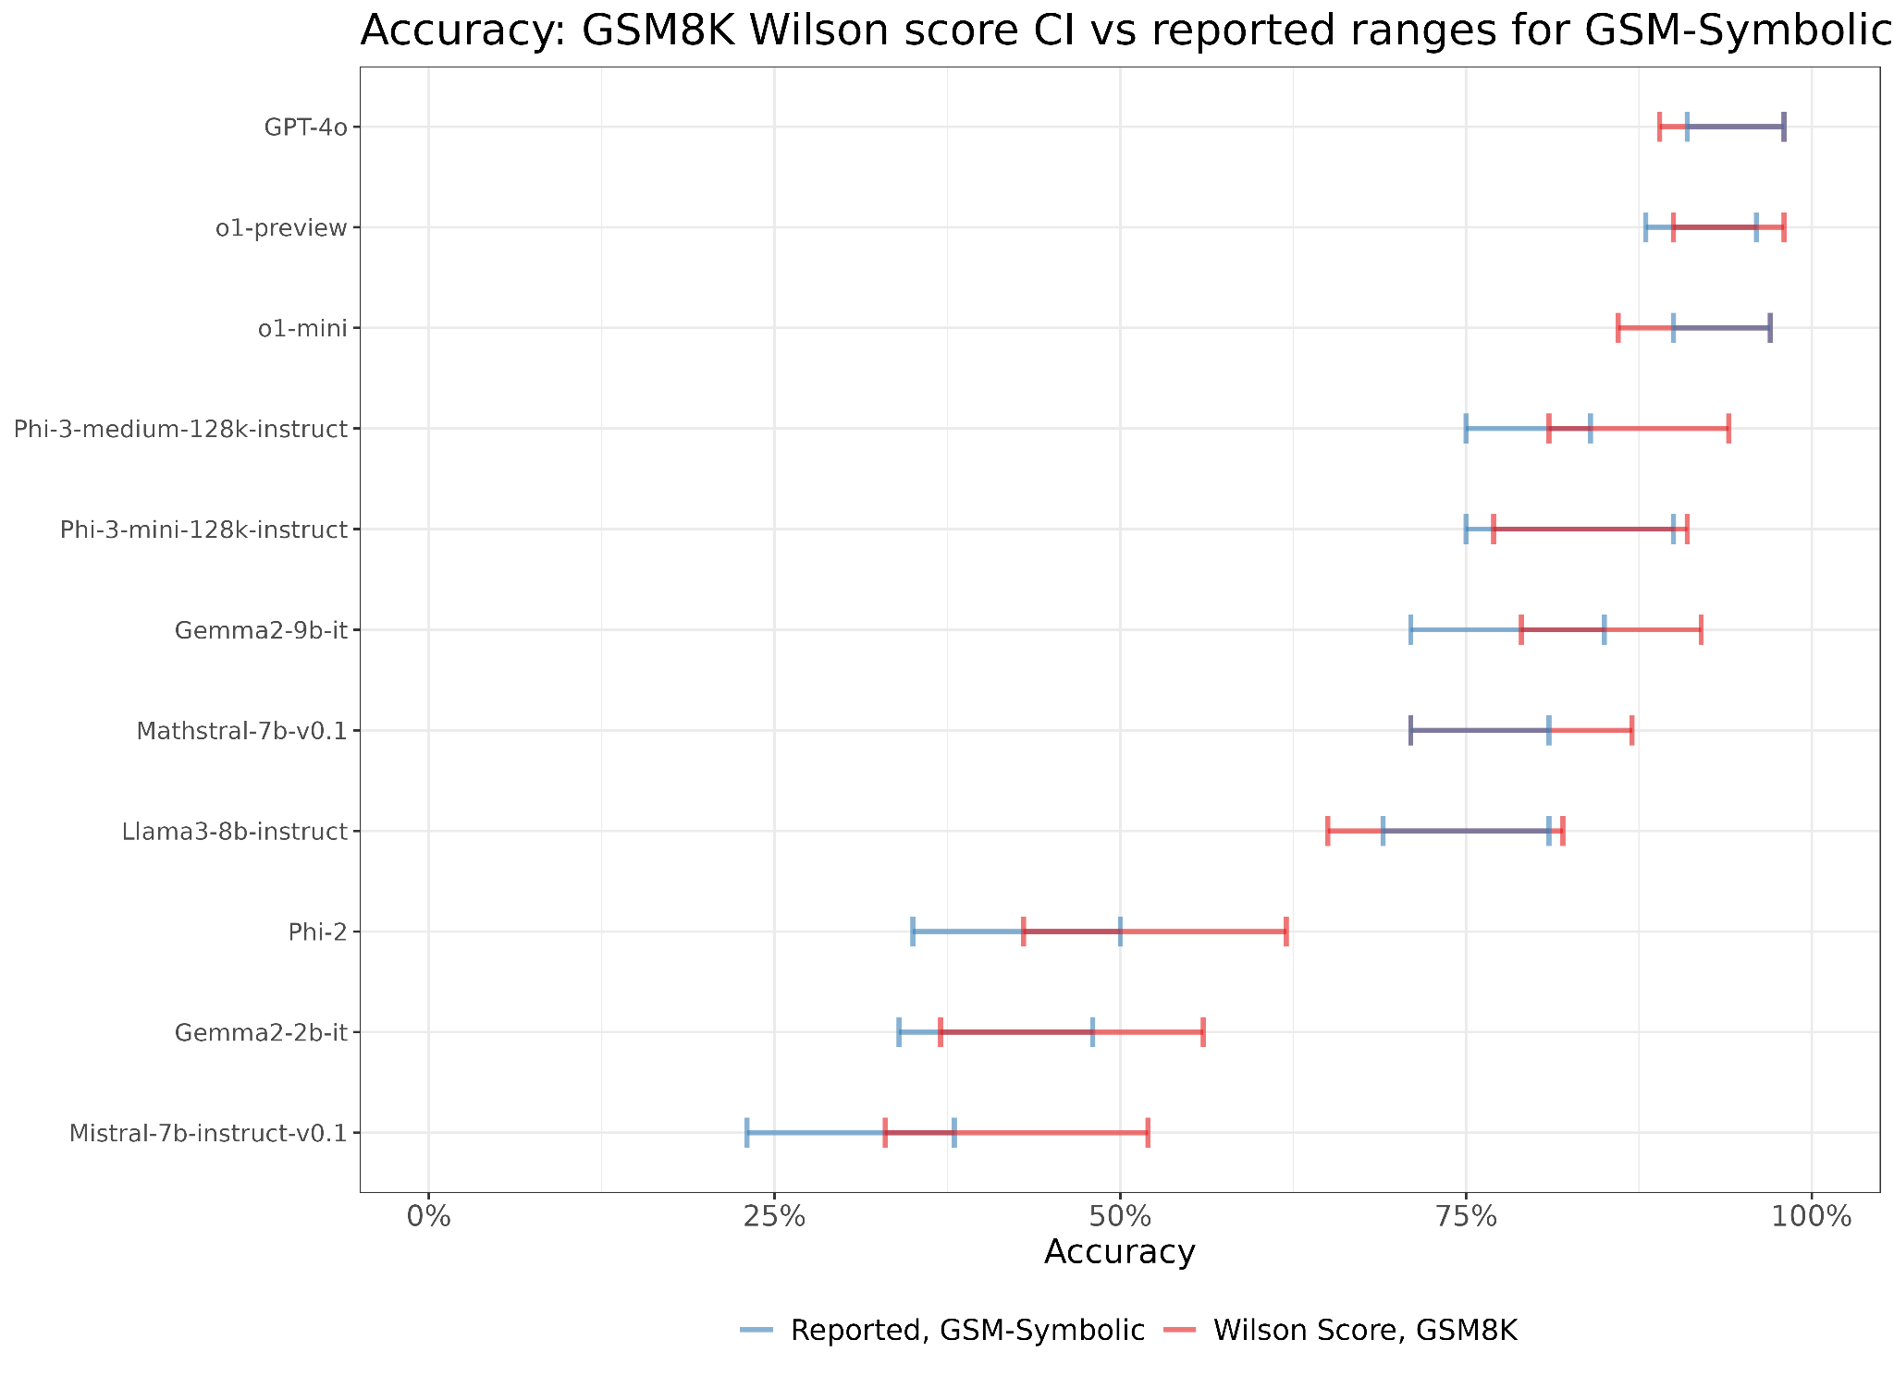
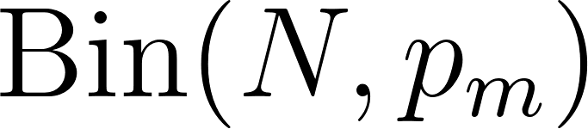
But claim 1 needs backing up
= #success
= #fail
Assume each model has a probability of success (the same across all questions).
Then the number of correct answers is .
So we can get (Wilson) confidence intervals.
Now it’s less obvious that model performance on GSM-Symbolic is actually worse than on GSM8K.

Slide 34
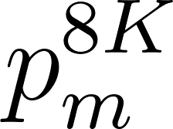




Is the drop in performance statistically significant?
Let be the true probability of success for model on GSM8K and be the true probability of success on GSM-Symbolic.
Run Fisher’s exact test on two-sided and one-sided hypotheses:

Slide 35
Is the drop in performance statistically significant?
Let be the true probability of success for model on GSM8K and be the true probability of success on GSM-Symbolic.
Run Fisher’s exact test on two-sided and one-sided hypotheses:

Slide 36
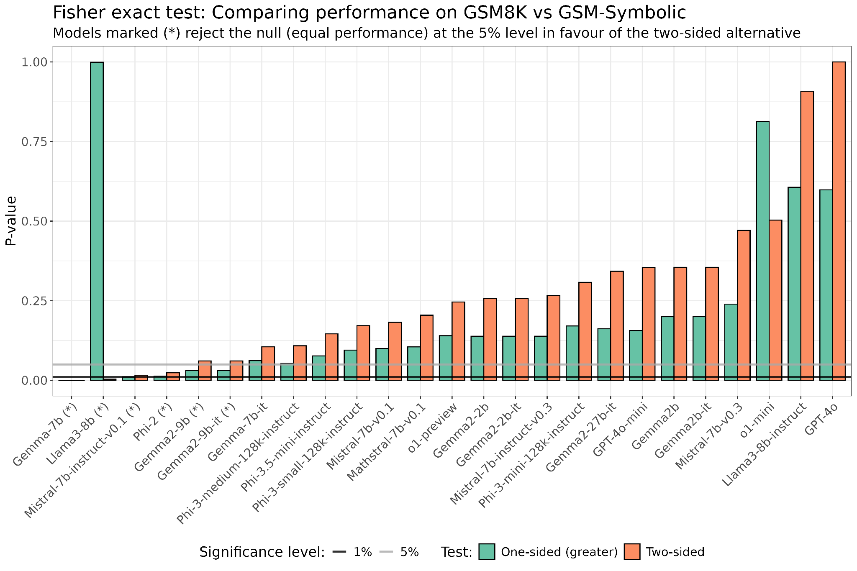
Is the drop in performance statistically significant? … Maybe
It turns out there is some (weak) evidence that the models are performing worse on GSM-Symbolic compared to GSM8K
(especially when you include irrelevant information in the questions)

Slide 37
Bayesian Error Bars
Can we do similar eval analysis/modelling with Bayes?
Yes!
Benefits:
Rather than confidence intervals (95% of which may contain the true parameter) we can use credible intervals and make direct statements such as “the true parameter lies in here with 95% probability”.
Allow for complex hierarchical modelling
Doesn’t rely on CLT (IID and large N assumptions)
Avoid complicated construction of frequentist setups (p-values shenanigans)
Drawbacks:
Have to choose priors carefully (actually not too much of an issue)
Computation (e.g. Stan)

Slide 38
Bayesian Error Bars
Can we do similar eval analysis/modelling with Bayes?
Yes!
Benefits:
Rather than confidence intervals (95% of which may contain the true parameter) we can use credible intervals and make direct statements such as “the true parameter lies in here with 95% probability”.
Allow for complex hierarchical modelling
Doesn’t rely on CLT (IID and large N assumptions)
Avoid complicated construction of frequentist setups (p-values shenanigans)
Drawbacks:
Have to choose priors carefully (actually not too much of an issue)
Computation (e.g. Stan)

Slide 39
Bayesian Error Bars
Can we do similar eval analysis/modelling with Bayes?
Yes!
Benefits:
Rather than confidence intervals (95% of which may contain the true parameter) we can use credible intervals and make direct statements such as “the true parameter lies in here with 95% probability”.
Allow for complex hierarchical modelling
Doesn’t rely on CLT (IID and large N assumptions)
Avoid complicated construction of frequentist setups (p-values shenanigans)
Drawbacks:
Have to choose priors carefully (actually not too much of an issue)
Computation (e.g. Stan)

Slide 40
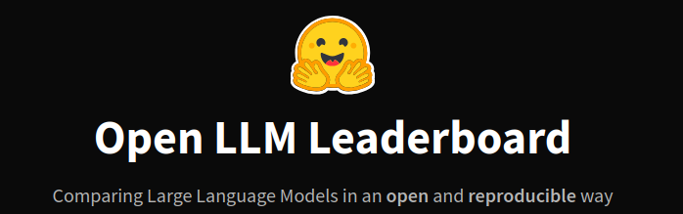
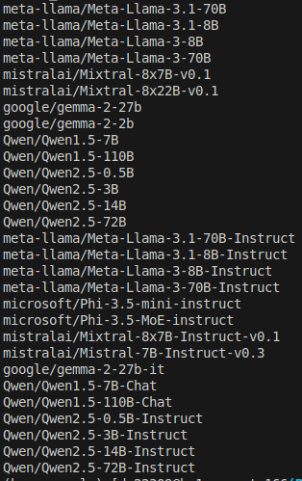
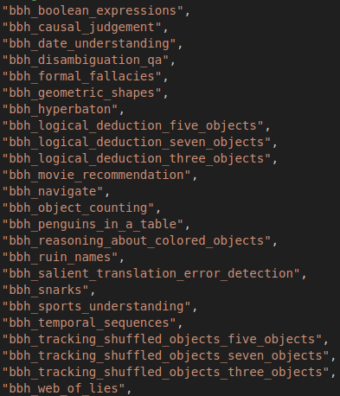

Experiments Setup
29 LLMs
actually have ~60
24 Tasks (BigBench Hard) (about 200-250 questions each)
actually have at least ~40 tasks
Raw eval binary data (success/fail) from Huggingface leaderboard

Slide 41
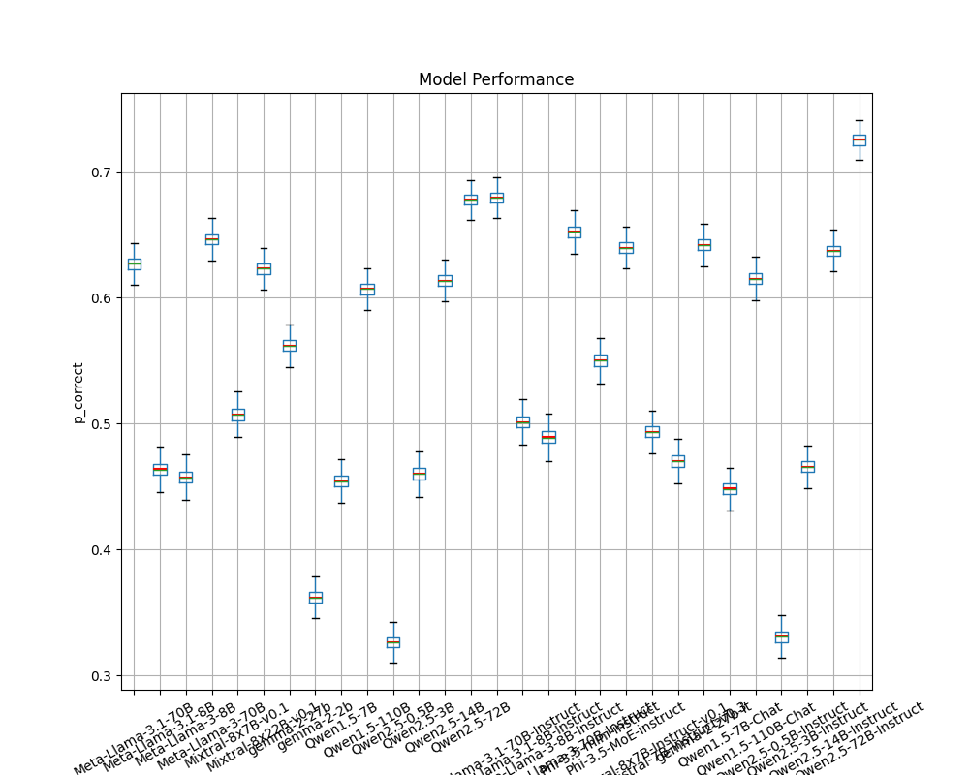
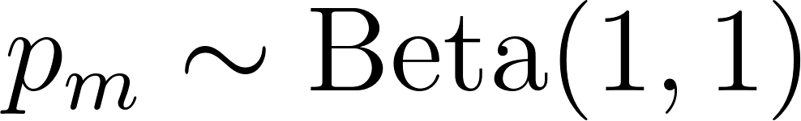
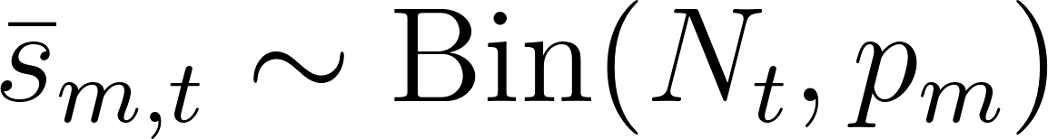
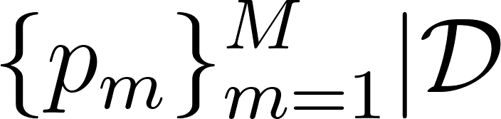
Model 1: Beta Binomial
Prior
Model
Infer

Slide 42
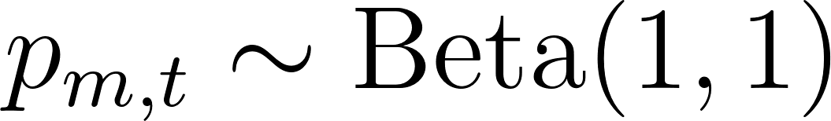
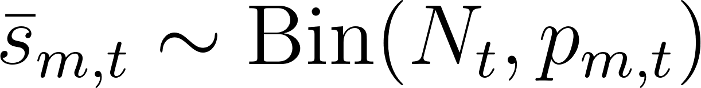
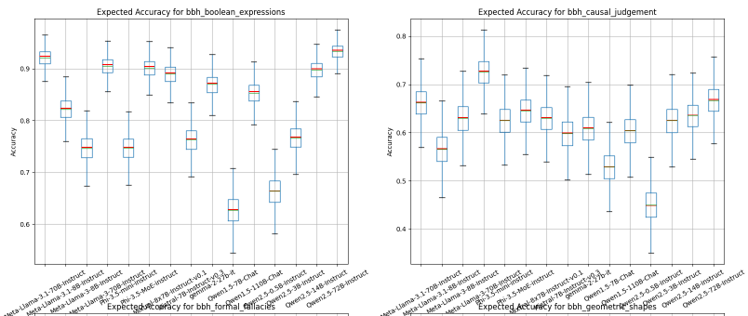
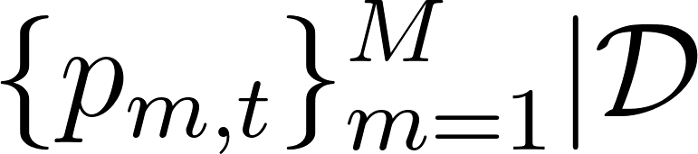
Model 2: Beta Binomial with per-task model performance
Prior
Model
Infer

Slide 43
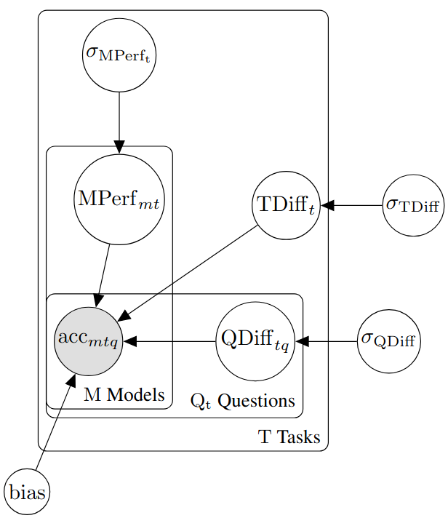
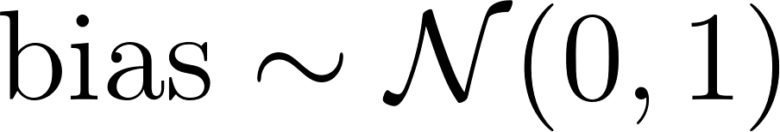
Model 3: Question-based model

Slide 44
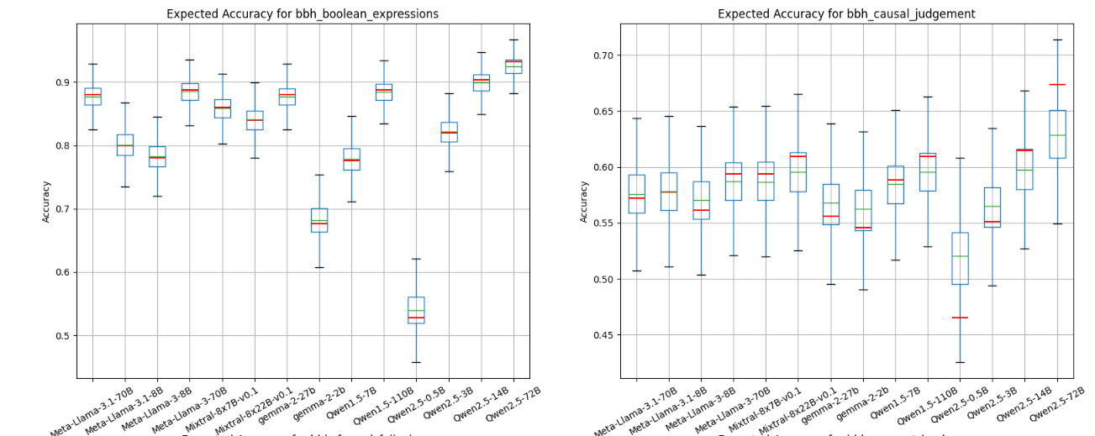
Model 3: Question-based model

Slide 45
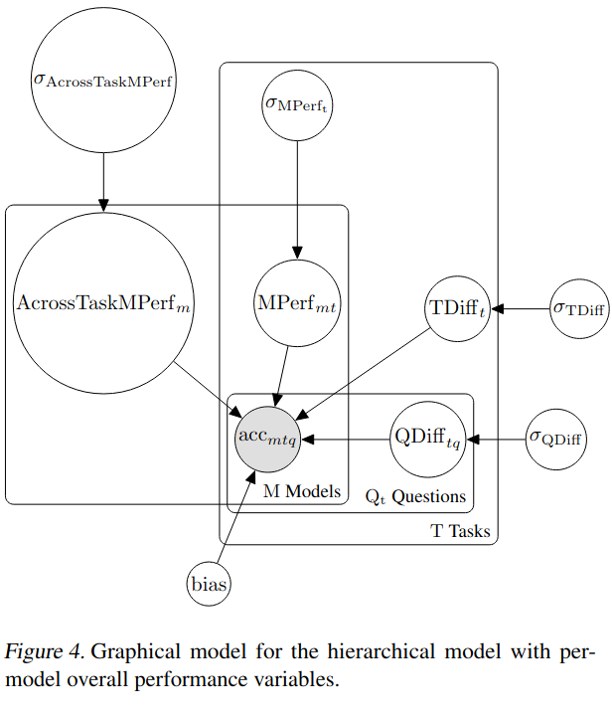
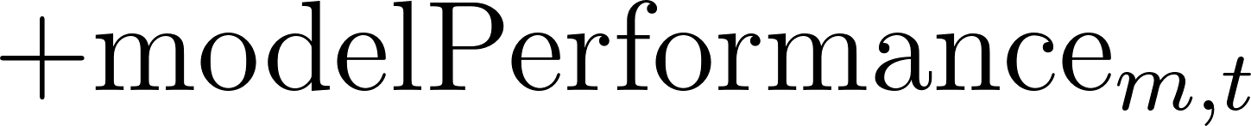
Model 4: Question-based model w/ across-task performance

Slide 46
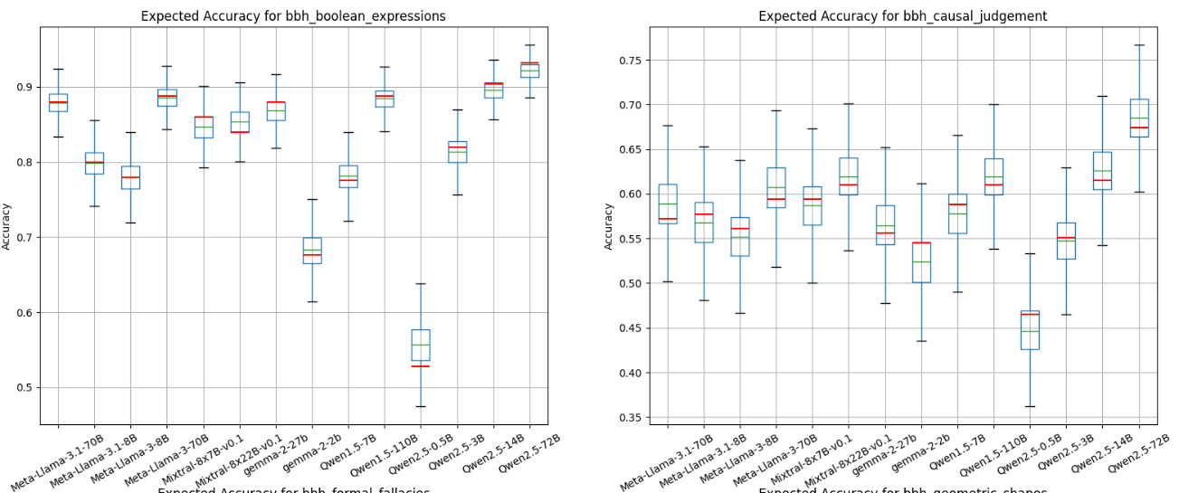
Model 3: w/ across-task performance

Slide 47
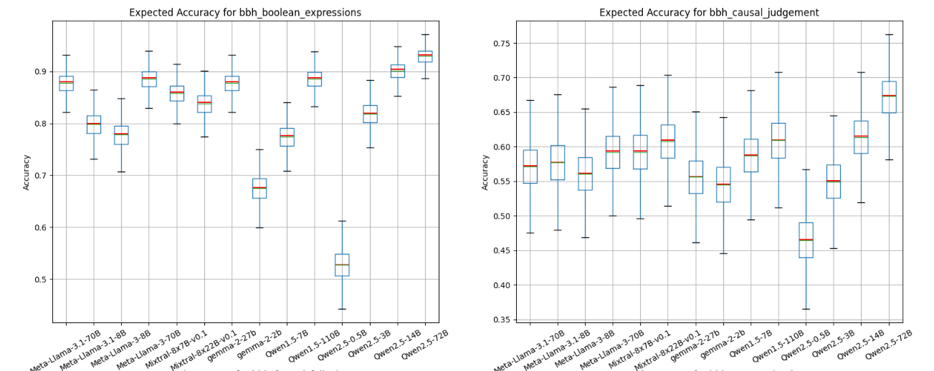
Model 2 vs 3 vs 4 - some (slight) reduction in size of error bars – needs frequentist comparison

Slide 48
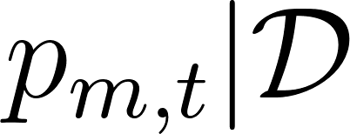



Bayesian hierarchical modelling for evals makes it easy to…
Easily find a Prob(Model A > Model B) – HMC gives us samples of , just look at
Elicit information about latent variables of interest:
Task difficulty
Per-task model performance
Capabilities*
* If we make modelPerformance and taskDifficulty vectors of length (say 5 or 7) with likelihood s.t. depends on their dot product, each dimension of those vectors might be interpretable as model/task capabilities e.g. arithmetic, grammar, logic etc.

Slide 49
Bayesian hierarchical modelling for evals makes it easy to…
Easily find a Prob(Model A > Model B) – HMC gives us samples of , just look at
Elicit information about latent variables of interest:
Task difficulty
Per-task model performance
Capabilities*
* If we make modelPerformance and taskDifficulty vectors of length (say 5 or 7) with likelihood s.t. depends on their dot product, each dimension of those vectors might be interpretable as model/task capabilities e.g. arithmetic, grammar, logic etc.

Slide 50
Bayesian hierarchical modelling for evals makes it easy to…
Easily find a Prob(Model A > Model B) – HMC gives us samples of , just look at
Elicit information about latent variables of interest:
Task difficulty
Per-task model performance
Capabilities*
* If we make modelPerformance and taskDifficulty vectors of length (say 5 or 7) with likelihood s.t. depends on their dot product, each dimension of those vectors might be interpretable as model/task capabilities e.g. arithmetic, grammar, logic etc.

Slide 51
References
Anthropic. 2023. ‘Challenges in Evaluating AI Systems’. 4 October 2023. https://www.anthropic.com/news/evaluating-ai-systems.
Biderman, Stella, Hailey Schoelkopf, Lintang Sutawika, Leo Gao, Jonathan Tow, Baber Abbasi, Alham Fikri Aji, et al. 2024. ‘Lessons from the Trenches on Reproducible Evaluation of Language Models’. arXiv. https://doi.org/10.48550/arXiv.2405.14782.
Grattafiori, Aaron, Abhimanyu Dubey, Abhinav Jauhri, Abhinav Pandey, Abhishek Kadian, Ahmad Al-Dahle, Aiesha Letman, et al. 2024. ‘The Llama 3 Herd of Models’. arXiv. https://doi.org/10.48550/arXiv.2407.21783.
Gu, Yuling, Oyvind Tafjord, Bailey Kuehl, Dany Haddad, Jesse Dodge, and Hannaneh Hajishirzi. 2024. ‘OLMES: A Standard for Language Model Evaluations’. arXiv. https://doi.org/10.48550/arXiv.2406.08446.
Hermann, Katherine, Jennifer Hu, and Michael Mozer. n.d. ‘Experimental Design and Analysis for AI Researchers’.
Ivanova, Desi. 2024a. ‘On Some (Fixable) Limitations of “Understanding the Limitations of Mathematical Reasoning in LLMs”’. 22 October 2024. https://substack.com/inbox/post/150508215?utm_campaign=post&triedRedirect=true.
———. 2024b. ‘Towards More Rigorous Evaluations of Language Models’. 28 November 2024. https://substack.com/home/post/p-152149873.
Liang, Percy, Rishi Bommasani, Tony Lee, Dimitris Tsipras, Dilara Soylu, Michihiro Yasunaga, Yian Zhang, et al. 2023. ‘Holistic Evaluation of Language Models’. arXiv. https://doi.org/10.48550/arXiv.2211.09110.
Miller, Evan. 2024. ‘Adding Error Bars to Evals: A Statistical Approach to Language Model Evaluations’. arXiv. https://doi.org/10.48550/arXiv.2411.00640.
Mirzadeh, Iman, Keivan Alizadeh, Hooman Shahrokhi, Oncel Tuzel, Samy Bengio, and Mehrdad Farajtabar. 2024. ‘GSM-Symbolic: Understanding the Limitations of Mathematical Reasoning in Large Language Models’. arXiv. https://doi.org/10.48550/arXiv.2410.05229.
Perez, Ethan, Sam Ringer, Kamilė Lukošiūtė, Karina Nguyen, Edwin Chen, Scott Heiner, Craig Pettit, et al. 2022. ‘Discovering Language Model Behaviors with Model-Written Evaluations’. arXiv. https://doi.org/10.48550/arXiv.2212.09251.
Polo, Felipe Maia, Lucas Weber, Leshem Choshen, Yuekai Sun, Gongjun Xu, and Mikhail Yurochkin. 2024. ‘tinyBenchmarks: Evaluating LLMs with Fewer Examples’. arXiv. https://doi.org/10.48550/arXiv.2402.14992.
Reuel, Anka, Amelia Hardy, Chandler Smith, Max Lamparth, Malcolm Hardy, and Mykel J. Kochenderfer. 2024. ‘BetterBench: Assessing AI Benchmarks, Uncovering Issues, and Establishing Best Practices’. arXiv. https://doi.org/10.48550/arXiv.2411.12990.
Song, Yifan, Guoyin Wang, Sujian Li, and Bill Yuchen Lin. 2024. ‘The Good, The Bad, and The Greedy: Evaluation of LLMs Should Not Ignore Non-Determinism’. arXiv. https://doi.org/10.48550/arXiv.2407.10457.

